Slide 1
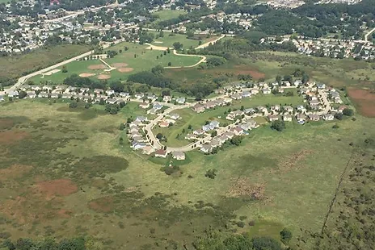
Commons Area, Water Mngt. Project
Summer Wind Annual HOA Meeting
May 6, 2023
Notes:
Line spacing + Page numbers

Slide 2
Project Progress Overview
Summer 2022-Present
Sent/Received Feedback Survey June ‘22, only inner circle residents
Wrote 5-page project description and facts overview – sent directly to all inner circle residents and made available via FB group to community.
Two culvert repairs w/swales completed by Andy Fering, Allied Excavating
One new culvert repair/swale seeded by Native Roots
South outlet cleaned out and dredged by city
North outlet, met on site late winter with City Engineer – work postponed until next winter/frozen ground.
  Cleaning of area around outlet needed. Residents must not dump dirt, blocks, grass clippings here – all will need to be removed or city may issue warnings and potentially fine if not removed. This area is a part of the Commons, not on lots. Purpose is to help reduce debris that can negatively impact the Outlet. The City has a compost bin at the Recycling Center for you to drop off grass and garden waste, or consider other ways of disposal, like grasscycling or composting.
Final design completed by Native Roots

Slide 3
Participation/Feedback Overview
32 Inner circle properties. 1 Rental House, not included in survey. 31 properties sent surveys.
Total participant responses: 21 via survey or direct feedback.
No/undecided Responses: 10
Survey

Slide 4
9 Approve - all directly border a design feature
8 Disapprove - 5 directly bordered a design feature
Since survey
~ 1 has approved border feature where needed
~ 4 now have no, or reduced, property border features
4 Neutral – all directly border a landscape feature
Since survey
~ 2 have approved design features bordering property, the others weren’t contacted
Approvals, disapprovals, neutrals and
those bordering “original” design features

Slide 5
Design Concerns
Size of prairies, specifically loss of turf grass and wanting more concise intervention areas
Closeness of features to property
Questions about cost/maintenance
Height of prairie plants, whether they may impact allergies
Ways to establish permanent, visual boundaries around prairie areas
Wildlife

Slide 6
Design “Likes”
  Flooding management and standing water reduction
  Improved aesthetics, landscaping
  Adding recreational activities and spaces, community benefit features
  Ecological benefits – such as runoff filtering before flowing into marsh
  Property Screening
  Wildlife, Trees and Native plants

Slide 7
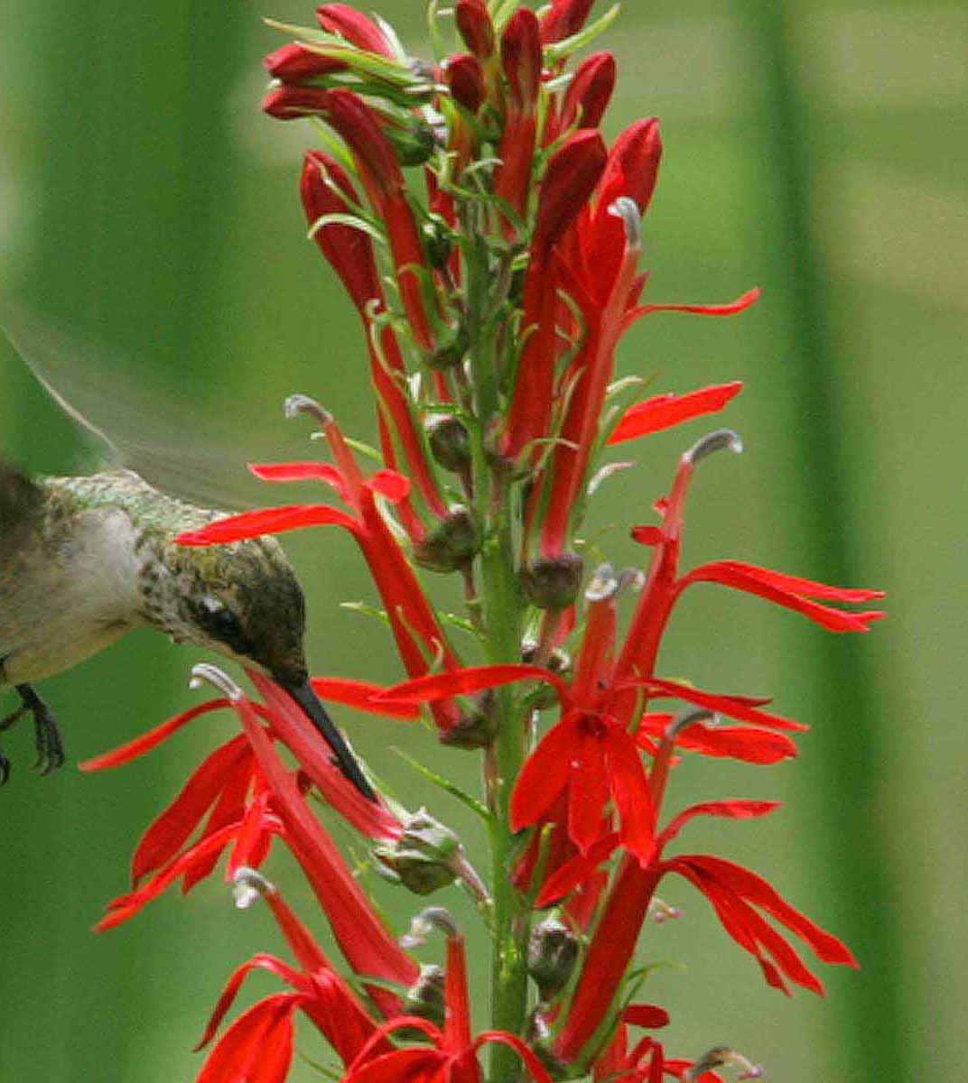
Regarding Wildlife – beneficial components of this landscaping approach include the creation of habitats that support the presence of pollinators, birds, etc., and development of a more balanced and self-maintaining ecological system.
~ Meeting with local DNR Wildlife Educator can be scheduled if the community desires, and if there is enough interest. Learn more about the types of wildlife native to our area, what species are most likely to be attracted to the design features, their benefits, and tips on how to reduce wildlife conflicts.
Regarding Native Plants – Wild Ones Menomonee River Area Branch collaboration.
~ Potential for a meeting/presentation by Wild Ones members to provide further community education and discussion around native plants and their use of in landscaping.

Slide 8
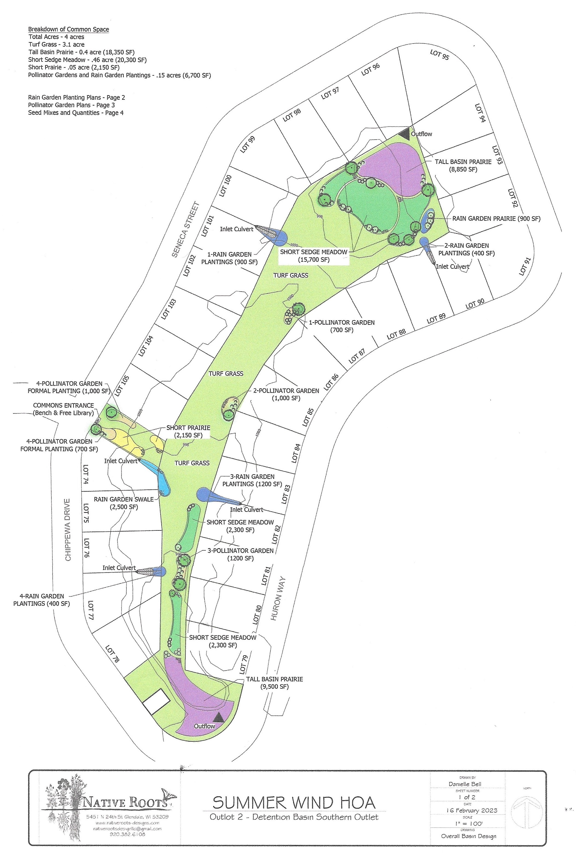
Final Design
‘23

Slide 9
Design Changes: made to incorporate community feedback, further assessment of water issues/mngt. needs and ongoing professional recommendations.
Budget: Formal beds instead of prairie/seeded areas increase costs. Cost of changes range up to abo. $15,000 more, depending what services and options we choose.
  Design features and costs presented as Al La Carte options to allow flexibility in what we want to have done vs. do ourselves – which is where most savings could occur.
  This years anticipated spending range is $7,900 up to $18,850 based on options chosen and community involvement.
Options to reduce costs:
  Choose seed mixes vs formal beds in some features.
  Bed prepping and/or installing live plants ourselves, can cut close to half the cost in most formal features.
    We’d need volunteers to commit to assisting with these projects before choosing this option.
      Consider forming a committee or making a list of volunteers.
      Consider a community event - offer food/drinks. One likely late summer or Fall this year.
  Apply for grants – a few identified, searching for more
  Fundraise
  Organization or community group: Wild Ones, Scouts group or Eagle Scout Project, etc.
  Explore purchasing/growing plants ourselves for formal beds at reduced cost
  Use of free city mulch for certain formal beds
  Search for free landscaping rocks – free transportation support or transportation as only cost

Slide 10
Design completed in yearly recommended phases: based on budget year Aug-Aug, as budget and design needs allow.
  Present to Winter ’23 anticipated design work
    Fall – Rain garden bed prep and plantings or seeding
    Fall/Winter – South Detention Basin Seeding and South Detention Basin Tree and Shrub Plantings
  Fall/Winter ‘24 anticipated design work
    North Detention Basin Seeding and North Detention Basin and Shrub Plantings
  Additional Design Features – Pollinator Gardens and Commons Entrance Beds
Culvert easement rain gardens. The rain garden options are designed as an alternative to larger prairies by improving water absorption and infiltration into the soil, etc., at the source.
  We will coordinate with property owners around culvert easement areas regarding the available options. Formal bed design vs seed mix, and live plant species.
  If choosing formal bed design, owners will need to agree to watering first season. By planting in Fall watering needs and duration reduced.

Slide 11
Seed Mix Pictures
Seed Mixes purchased from Prairie Moon Nursery and Prairie Nursery. Additional information on their websites: www.prairiemoon.com
www.prairienursery.com

Slide 12
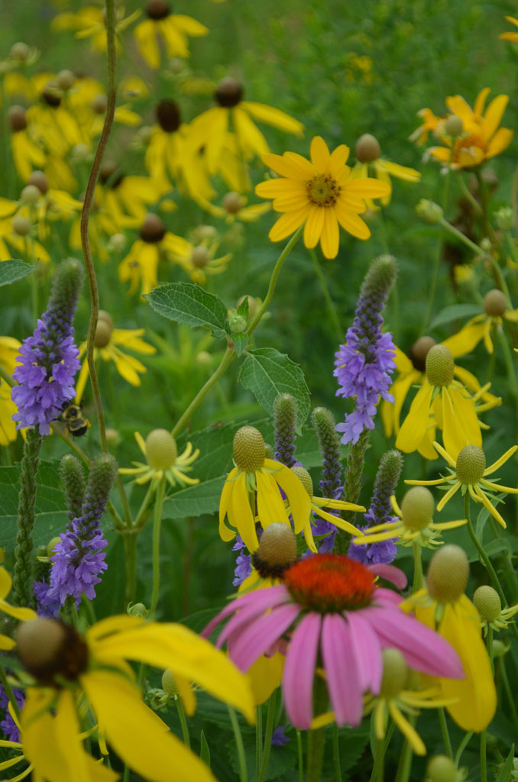
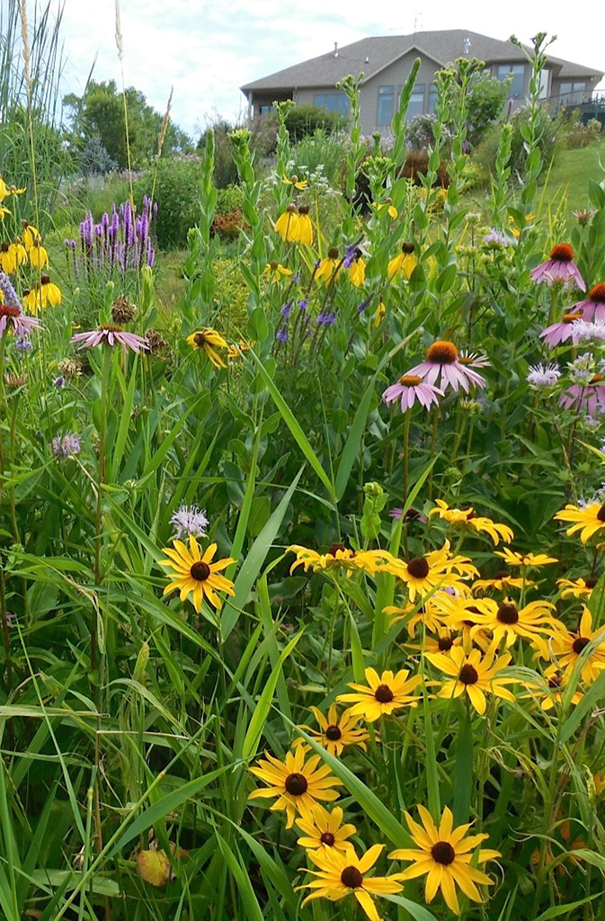
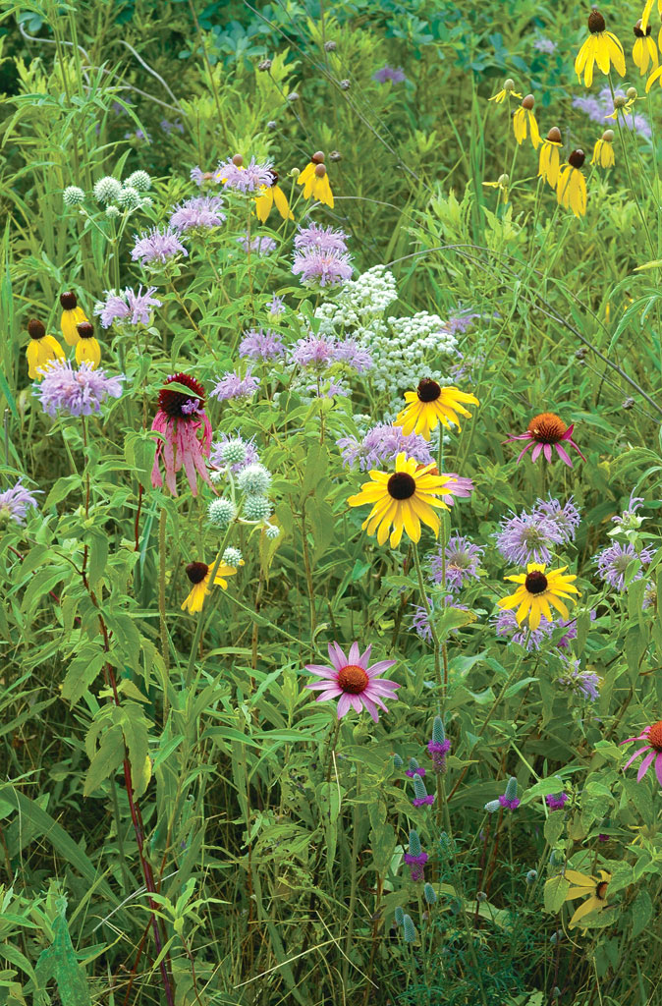
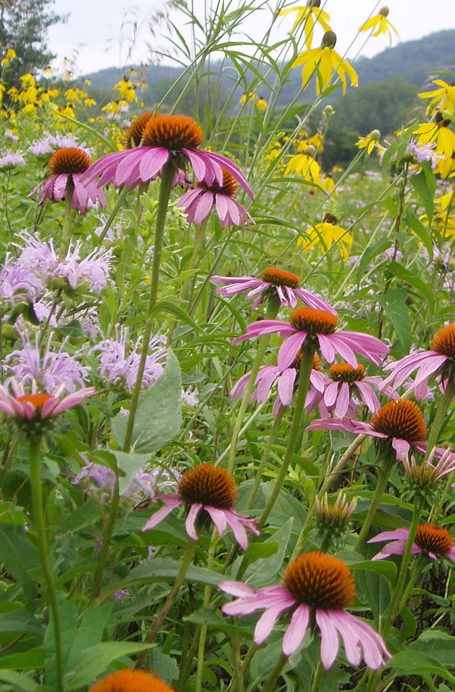
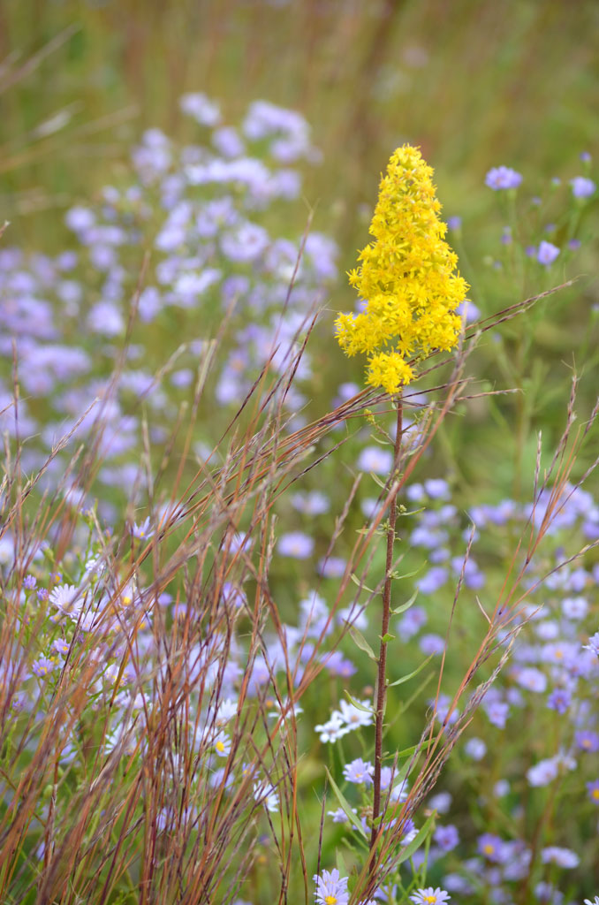
Completed Culvert/Bioswale Seeding
“Pretty Darn Quick Seed Mix”
Summer
FALL

Slide 13
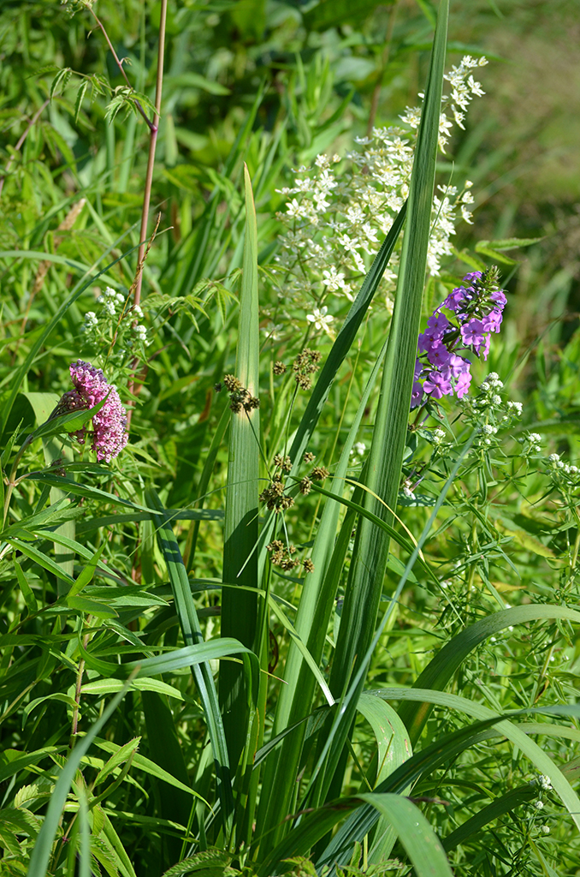
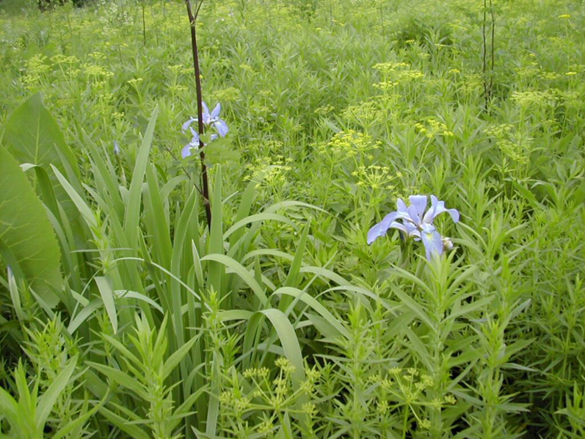
Short Sedge Meadow Seed Mix
Jun

Slide 14
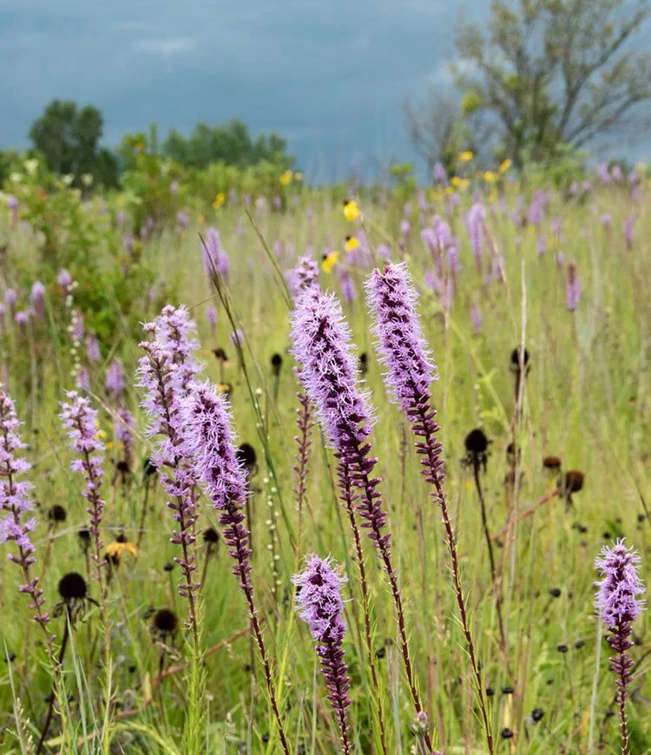
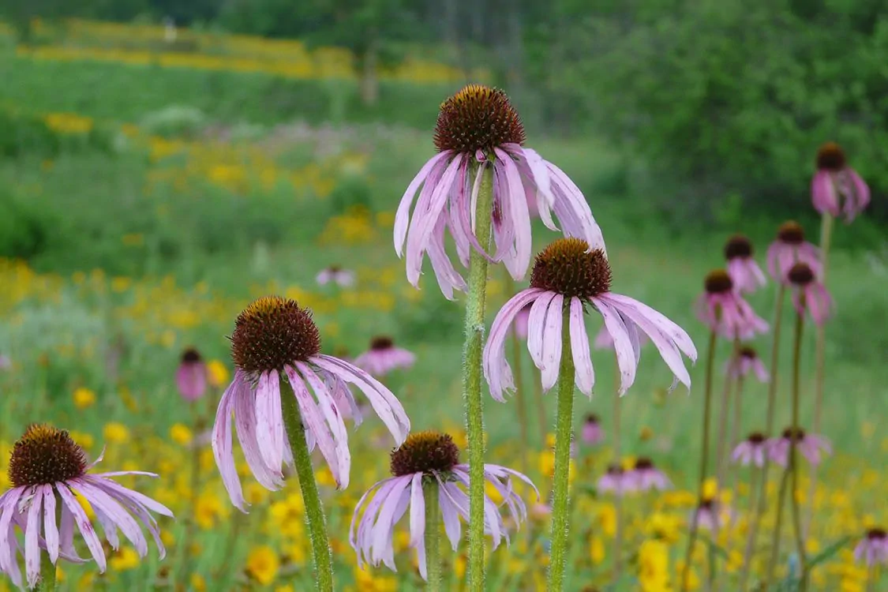
Short Prairie Seed Mix

Slide 15
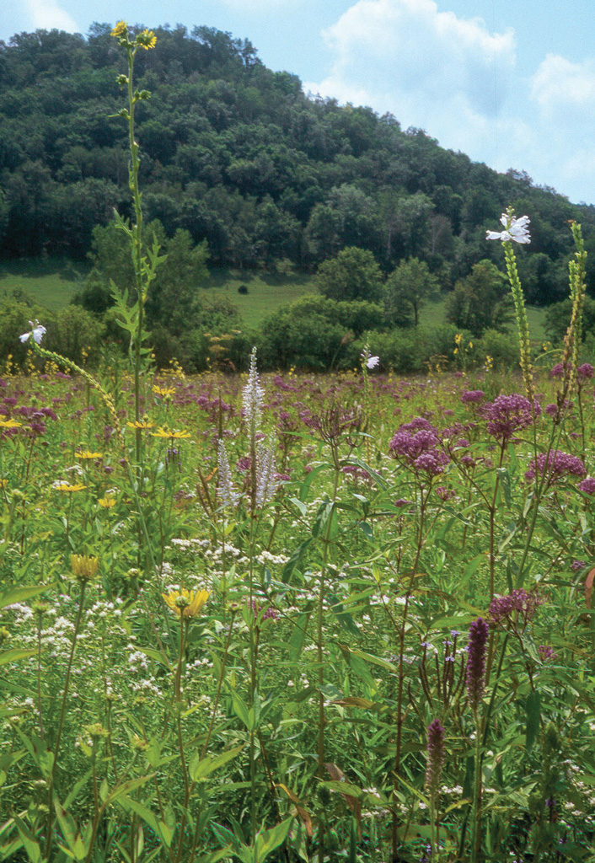
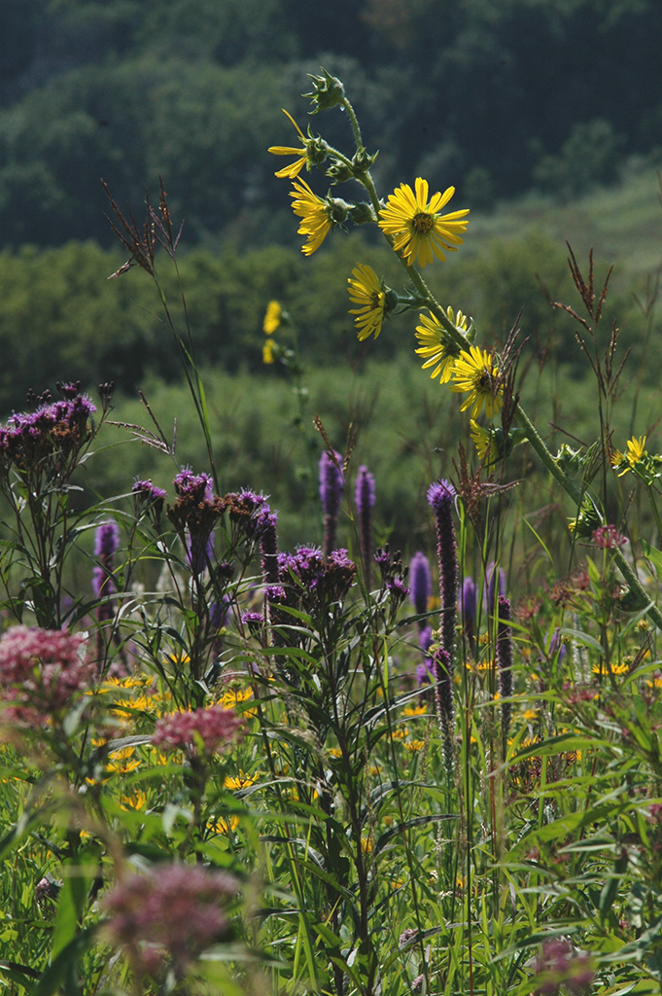
Tallgrass Basin Seed Mix

Slide 16
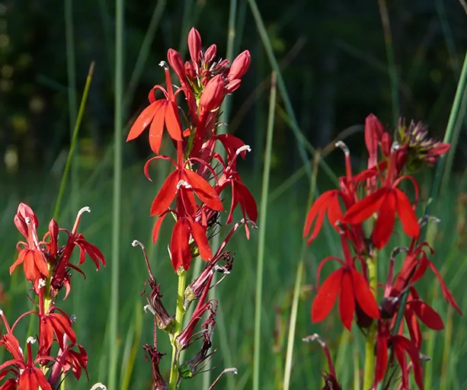
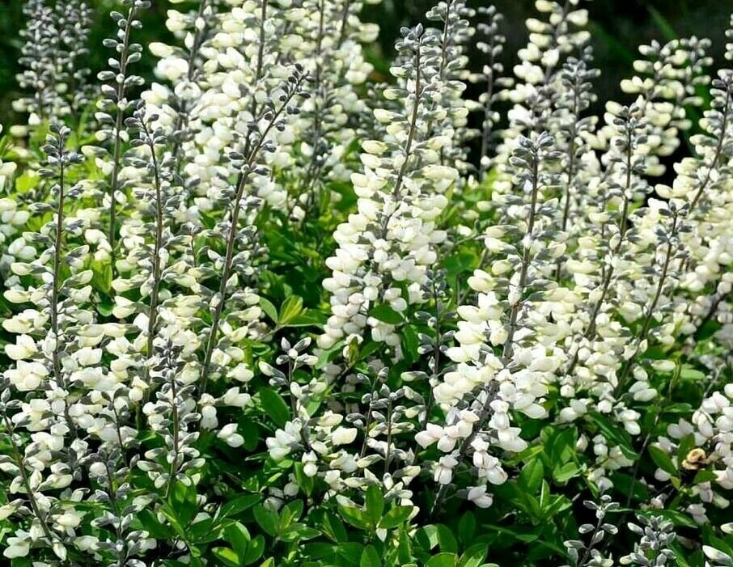
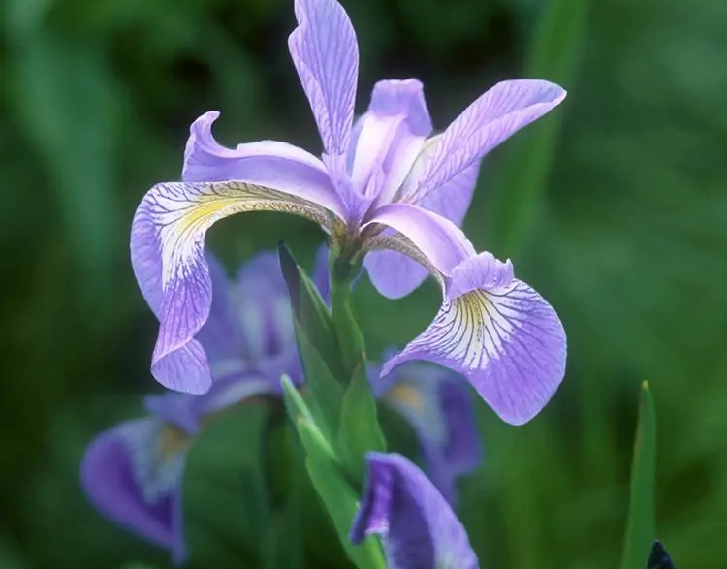
Rain Garden Seed Mix
(Examples)
This will be a custom mix to include:
Rain Garden Species List Flowers: Meadow Anemone, Blue Flag Iris, Golden Alexander, Cardinal Flower, Swamp Milkweed, Meadow Blazingstar, Turtlehead, Brown Eye Susans, Riddell’s Goldenrod, White Indigo.
Sedges/Grasses: Brown Fox Sedge, Porcupine Sedge, Palm Sedge, Common Rush, Bebb’s Sedge.

Slide 17
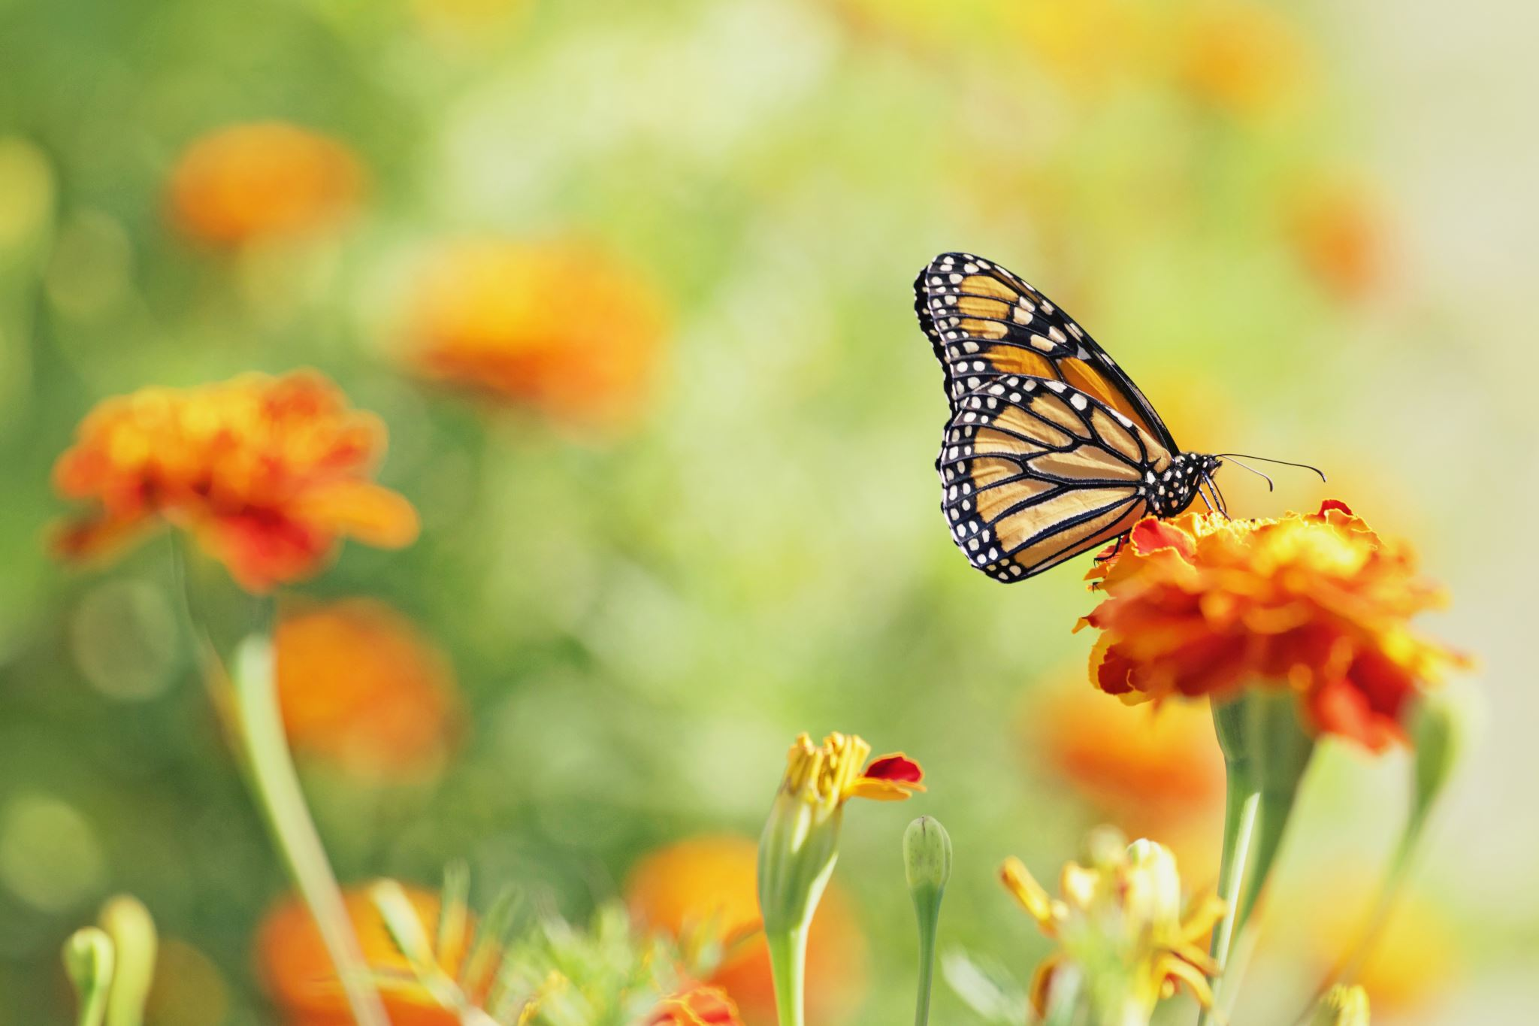
Next steps for 2023/24 budget year:
Survey/stake property lines around the commons.
North end Trees/Outlet work to be done by city in Winter ’23
Focus on South end prairie seeding and raingarden installations
Estimated expenses: TBD – based on options and methods we choose. Would like to fall
somewhere in lower to middle of price range previously outlined.
Set up DNR Wildlife Educator meeting and Wild Ones presentation, based on community interest.
Consider starting committee to support commons area and project needs – planting, prep work, community outreach, fundraising, ways to benefit community over time (ie. Educational signs, installations like benches, tables, frisbee golf course, wildlife/bird viewing, bird houses, etc.).
Explore ways to get free or reduced cost landscaping rocks to help define beds. FB marketplace has them. Would need to find way to load, haul and place for larger pieces. Anyone with connections or personal equipment that would volunteer? Also explore cedar fencing options.
Continue exploring additional funding options and start applying for 2024 grants.
  Wild Ones has scholarship program to support community native planting projects that provide education to children. Plan to apply next yr – goal to help support entrance bed costs and potential educational signs in this area.

Slide 18
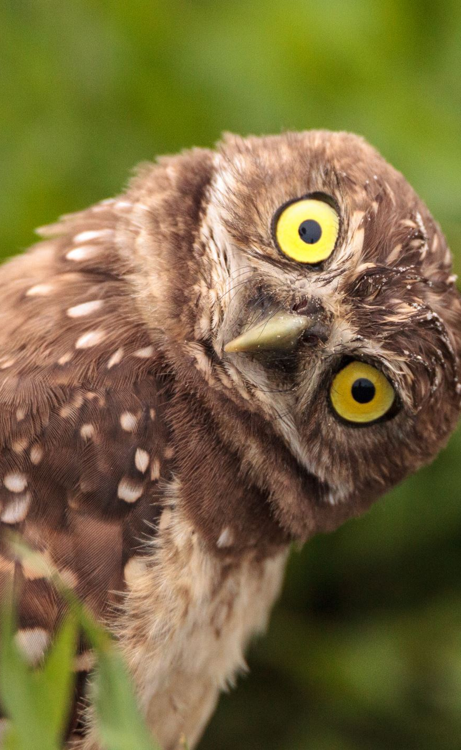
Thank you for joining us and your interest in this project.
Questions?

